Slide 1
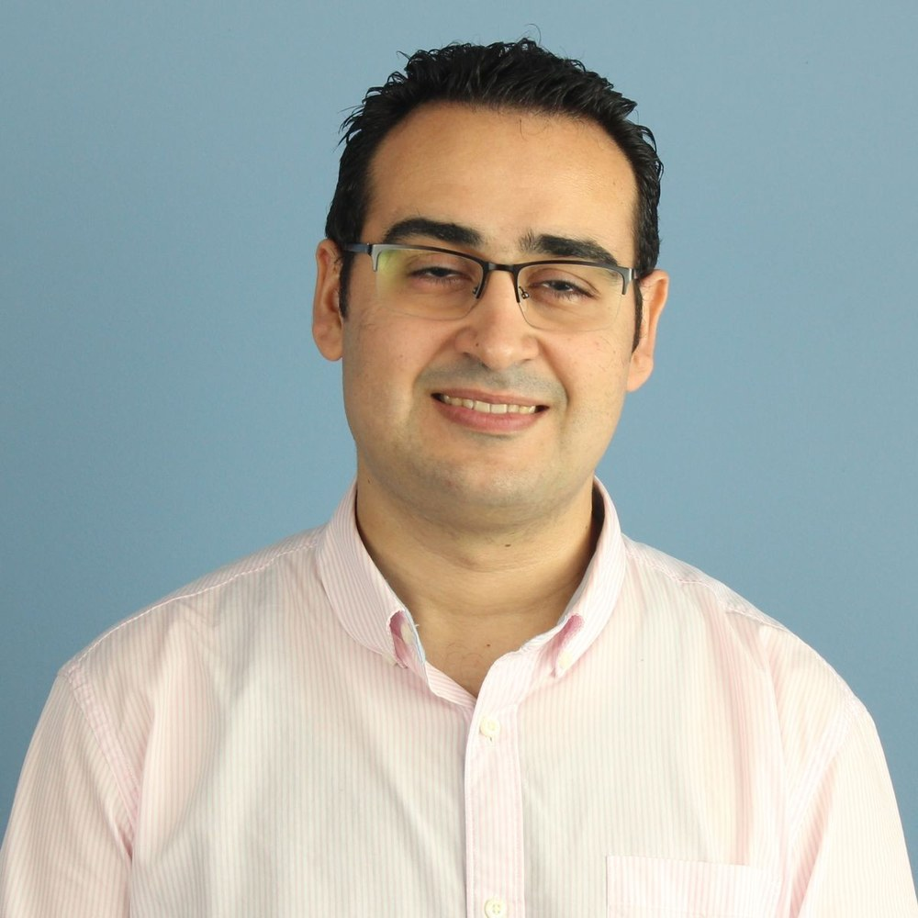
IAGO TRILLO OJEA
EXECUTIVE PRESENTATION
Iago Trillo Ojea
Global Supply Chain Director
Supply Chain | Operations & P&L | Leadership | Digital Transformation
Europe | Asia | Americas
iagotrillo.com

Slide 2
01
01 | CURRENT SCOPE
Global responsibility with operating depth.
Global Supply Chain: planning, inventory, logistics and service.
Additional responsibility: Supply Chain & Operations Digital Transformation.
Cross-functional work with Operations, Sales, Purchasing, Finance, IT and local teams.
150+
3
6
people
regions
D365 subsidiaries
Iago Trillo Ojea

Slide 3
02
02 | CAREER EVOLUTION
From process engineering to global leadership and plant P&L.
Engineering -> Supply Chain execution -> planning/logistics -> information processes -> global operating model -> plant leadership.
International stages in the UK and India, with current responsibilities across Europe, Asia and the Americas.
2015
2024
2026
industrial start
Plant Director India
Global Supply Chain Director
Iago Trillo Ojea

Slide 4
03
03 | GLOBAL SUPPLY CHAIN
A common operating model for an international network.
Decision ownership and cadence.
Integrated demand, supply and capacity.
Inventory governance connected to service and cash.
Cross-regional flows, KPIs and exception escalation.
~EUR140M -> ~EUR200M
150+
Europe | Asia | Americas
business scale
people
network
Iago Trillo Ojea

Slide 5
04
04 | INVENTORY & WORKING CAPITAL
Reduce coverage without using service as the balancing variable.
Segment by behaviour and criticality.
Adjust buffers to risk.
Review MOQ/MRP parameters that create structural stock.
Redistribute before buying/producing again.
Surface obsolescence early.
~175 -> ~135
>20%
days
coverage reduction
Iago Trillo Ojea

Slide 6
05
05 | OPERATIONS & P&L - INDIA
Full plant responsibility in an international assignment.
P&L, Operations, Supply Chain, Quality, IT, HR and local leadership.
Organization, shifts, planning, logistics and quality managed as one operating system.
MES, BI and automation used to improve visibility and control.
129%
+30%
+13%
sales vs budget
EBT
efficiency
Iago Trillo Ojea

Slide 7
06
06 | CAPACITY, LOGISTICS & RESILIENCE
Design capacity before growth becomes the bottleneck.
Zaragoza Industrial Park: scenarios, capacity, layout, flows and phased investment.
COVID planning: frequent replanning, MRP/MPS discipline, capacity and selective contingency.
Logistics depth: intralogistics, warehousing, transport and service reliability.
+41%
~60
Zaragoza growth context
planning/logistics team at peak stage
Iago Trillo Ojea

Slide 8
07
07 | DIGITAL DECISION ARCHITECTURE
Business decision first. Technology second.
Decision -> process/governance -> ERP -> execution/planning -> data -> last-mile automation.
D365, Siemens Opcenter MES/APS, Blue Yonder WMS, BI, analytics, digital twin and specific web tools.
6
ERP + MES/APS + WMS
D365 subsidiaries
connected stack
Iago Trillo Ojea

Slide 9
08
08 | LEADERSHIP & INTERNATIONALIZATION
Clarity, trust and autonomy across cultures.
Direct leadership: India plant, Zaragoza planning/logistics, global/local Supply Chain.
Cross-functional leadership: ERP, inventory, S&OP, capacity and digital transformation.
Principle: develop managers so the system becomes less dependent on the leader.
UK
India
3 regions
engineering
plant P&L
global scope
Iago Trillo Ojea

Slide 10
09
09 | EDUCATION & APPLIED CAPABILITIES
Executive development on top of an industrial engineering base.
Global Executive MBA | EAE.
Master in Operations & Logistics | University of Zaragoza.
Advanced Aerospace Engineering | Queen's University Belfast.
MSc Industrial Engineering | University of Vigo.
Applied learning: Power BI, SQL, Python, AI, databases and web solutions.
10+
4
years industry
major academic stages
Iago Trillo Ojea

Slide 11
10
10 | VALUE PROPOSITION
Operating leadership with the ability to reach the final digital layer.
Strongest fit: Global Supply Chain, Operations/Plant leadership, Business Transformation and Supply Chain & Operations Digital Transformation.
Differentiator: connect strategy, operating mechanisms, people, enterprise systems, data and targeted automation.
CV
Dossier
Cases
screening
depth
proof
Iago Trillo Ojea

